Slide 1
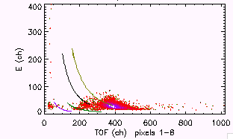
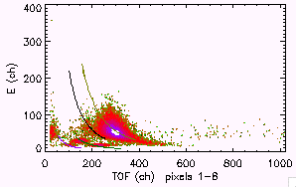
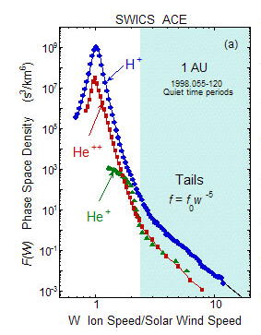
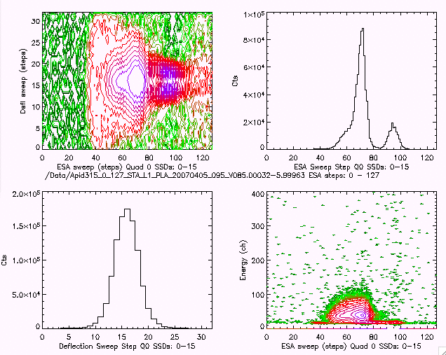
Suprathermal Tails in Solar Wind Oxygen and Iron D22-0051-08
Mark Popecki¹, A. Galvin¹, L. M. Kistler¹,H. Kucharek¹, E. Moebius¹, K. Simunac¹, P. Bochsler², L. M. Blush², R. Karrer², H. Daoudi², B. Klecker³, R. F. Wimmer-Schweingruber⁴
1. University of New Hampshire, Durham, NH 03824 USA
2. Physikalisches Institut, University of Bern, Switzerland,
3. Max-Planck Institut fuer extraterrestrische Physik, Germany
4. Institute for Experimental and Applied Physics, University of Kiel, Germany.
Abstract: High speed suprathermal tails with a fixed energy spectrum have been observed in solar wind H and He2+, as well as in He+ pickup ions (e.g. Gloeckler et al., 2007). These tails appear to have a persistent and constant power law energy spectrum, unchanged in a variety of solar conditions. The presence of the tails have implications for particle injection into the interplanetary shock acceleration process. The suprathermal tails of ions heavier than H and He may be investigated with the STEREO/PLASTIC mass spectrometer, for speeds up to several times the solar wind speed. The energy spectra of solar wind O and Fe are presented for periods of slow and fast solar wind. Variations in energy spectra will be discussed.
4
7
Counts/keV vs. V/V_{H}
Fe and O counts/keV vs. S/W speed ratio are shown.
Variations are apparent in intensity rollover near peak.
High speed O tends to fall off faster than low speed O.
The rollover is broader in high speed Fe.
Fast and Slow S/W Selection
Select examples of fast and slow solar wind.
Obtain the energy spectrum of Fe and O.
Three days chosen…
  Fast:
    2008/007 (<V_{sw}> = 621 km/s)
  Slow:
    2007/340 (Dec 6)
    2007/341 ( <V_{sw} > = 305 km/s)
    2007/255-257 ( <V_{sw} > = 294, 288, 293 km/s)
    2007/290 ( <V_{sw} > = 311 km/s)
Get counts/energy step.
Use Q state to get counts/speed step.
Fe for Fast and Slow S/W Periods
Low Speed
2007/340
2.8-3.0 keV/e
Vsw = 305 km/s
High Speed
2008/007
16.2-17.9 keV/e
Vsw = 621 km/s
O
Fe
O
Fe
1
Suprathermal Tails in H & He
High speed tails have been observed in solar wind H⁺ and He⁺⁺, as well as in pickup He⁺ (Gloeckler, Gloeckler & Mason; see ACE News #98).
Tails have implications for particle injection into the shock acceleration process.
Above speeds of ~2V_{sw}, the tails appear to have a constant profile regardless of solar wind conditions.
The slope goes as (V_{ion}/V_{s/w})-5 in phase space density, and as E^{-1.5} in energy.
We will investigate heavy ion speeds and characterize possible tails in ions heavier than He.
Using STEREOPLASTIC:
  The energy spectrum of O and Fe may be obtained from periods of high and low speed solar wind.
Fe and O Counts vs. Energy/charge
We now have spectra in energy/charge.
Next extract ionic charge states and get energy from energy/charge…
5
Low speed
ACE News #98
High speed
2
Switch from large to small aperture
8
STEREO/PLASTIC
Heavy Ion Measurements
Energy range:
  0.3 - 78 keV/e one-minute cadence sweep
Selection: E/q
Measurements:
  Time of Flight,
  Residual Energy (SSD)
All ions are counted and classified (priority rates)
Sample pulse height events are brought down.
Ions are identified by pulse height measurements.
Ion-specific rates are obtained by combining pulse height count with priority rates.
6
Q(E) for high and low speed O and Fe
Average charge states are shown for each ESA step range: Q(E).
Charge state tends to decrease with increasing energy.
The charge states and ESA step energies together provide the average energies.
O
Fe
He+ pickup ions
He2+
H+
78 keV/e
1 keV/e
Counts/keV vs V/V_{H} for Fe in low speed periods
(V_{sw} ~ 300 km/s)
sweep
Sweep step 0
(highest energy/e)
Summary
• The energy spectra of solar wind O and Fe have been calculated for low and high speed periods.
Both O and Fe count spectra display tails above the H+ solar wind speed.
Spectral variation appears to take place in both ion species
  Variations are apparent in intensity rollover near peak; rollover is broader in fast solar wind Fe example.
  High speed O tends to fall off earlier than low speed O.
Ionic charge states decrease with increasing energy in both Fe and O.
Next steps:
  Energy spectra need to be extended to >2V_{H} … combine more days to improve statistics.
  Instrument efficiencies will be applied to convert counts to fluxes
  Transfer results to solar wind frame.
3
Solar Wind Ions:
Essd vs. TOF
Ion species may be separated by plotting E_{ssd} vs. Time of Flight
Each element forms a characteristic trail, regardless of charge state and energy
O5+
Ion Species in TOF-E_{ssd} Space
H
Fe
He
O+
Sweep step 127
(lowest energy/e)
O

